Slide 1

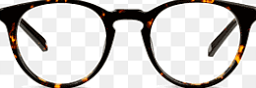
Warby Parker:
A Cross-Sectional Study of “Sales”
by Scott Burton

Slide 2
Outline
Results of the Style Quiz
Trends in the the Home Try-On Experience
Final Recommendations

Slide 3
1. Results of the Style Quiz

Slide 4
Progression Through the Style Quiz
As would be expected, the number of survey responses decrease* the further the users progress into the survey
Potential causes:
Response fatigue/life getting in the way
Overwhelmed by all of the great options Warby Parker offers?
Not having a current/recent glasses prescription
SELECT question, COUNT(DISTINCT user_id)
FROM survey
GROUP BY 1
ORDER BY 1 ASC;
Question # | Number of Responses | Percent Flow
1 | 500 | -
2 | 475 | 95%
3 | 380 | 80%
4 | 361 | 95%*
5 | 270 | 74.8%

Slide 5
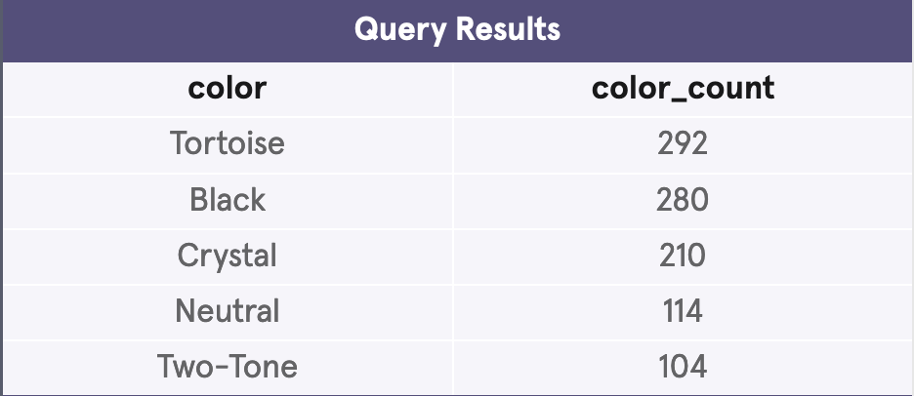
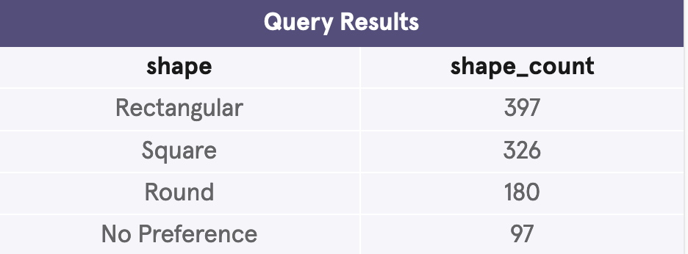
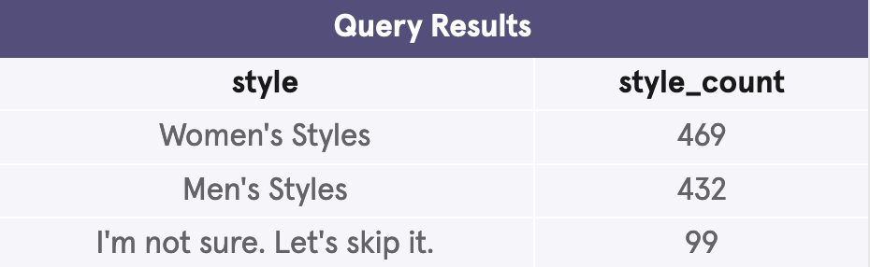
Descriptive Summary of the Quiz Results
Overall, tortoise is the most popular color, follow closely by black
Note that two-tone ranks lowest in the list for overall survey results…
The rectangular and square shapes are favored before home-try on
Marginally more of the survey respondents were interested in female frame styles
SELECT color,
COUNT(color) AS color_count
FROM quiz
GROUP BY color
ORDER BY color_count DESC;
SELECT shape,
COUNT(shape) as shape_count
FROM quiz
GROUP BY shape
ORDER BY shape_count DESC;
SELECT style,
COUNT(style) as style_count
FROM quiz
GROUP BY style
ORDER BY style_count DESC;

Slide 6
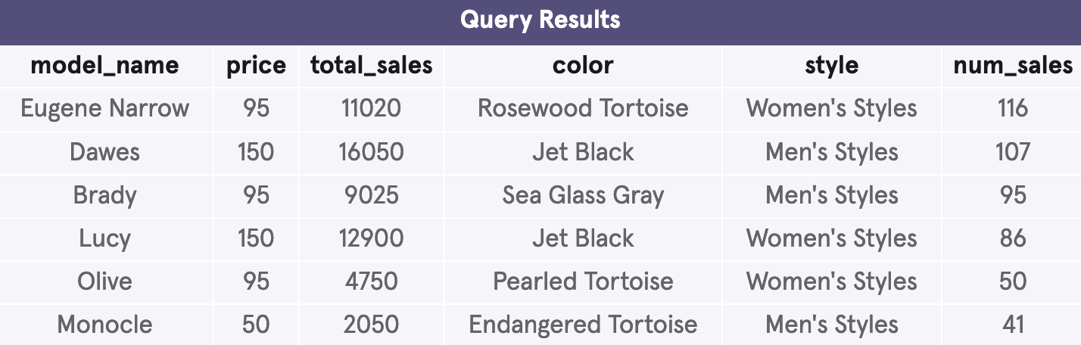
…Compared with Actual Purchases
SELECT model_name,
price,
SUM(price) AS total_sales,
color,
style,
COUNT(user_id) AS 'num_sales'
FROM purchase
GROUP BY model_name
ORDER BY num_sales DESC;
Actual purchase data is reflective of tortoise varieties and black being the most popular colors, both in terms of number of sales and cumulative sales

Slide 7
2. Trends in the
Home Try-On Experience

Slide 8
The Purchase Pipeline
Website**
Quiz
Home Try-On
Purchase
**We don’t currently have any data tracking the click rate from landing on the WP website to accessing the quiz— so this would be the first step in the funnel if we did
-- The purchase funnel
WITH funnel AS (
SELECT quiz.user_id,
EXISTS (
SELECT * FROM home_try_on WHERE quiz.user_id = home_try_on.user_id)
AS 'is_home_try_on',
home_try_on.number_of_pairs,
EXISTS (
SELECT * FROM purchase WHERE home_try_on.user_id = purchase.user_id)
AS 'is_purchase'
FROM quiz
LEFT JOIN home_try_on
ON quiz.user_id = home_try_on.user_id
LEFT JOIN purchase
ON home_try_on.user_id = purchase.user_id
)
quiz_details AS (
SELECT * FROM funnel
INNER JOIN quiz
ON funnel.user_id = quiz.user_id
)
. . .
—- follow on queries

Slide 9
Conversion Rates Through the Funnel
The rate of people moving from the style quiz to home try-on is higher than the rate from home try-on to purchase
Maybe we need to recommend the hottest selling frames for their preferences
Maybe we need to send them more frames to try on
--Calculate the conversion rate from quiz to home try on
SELECT 100.0 * AVG(is_home_try_on)
FROM funnel;
-- 75%
--Calculate the conversion rate from try-on to purchase
SELECT 100.0 * SUM(is_purchase) /
SUM(is_home_try_on)
FROM funnel;
-- 66%
Sample | Survey to Try-On Conversion | Try-On to Purchase Conversion
Everyone surveyed | 75% | 66%

Slide 10
Purchase Conversion Rate Across the A/B Study
Our analysis shows that the purchase conversion rate when the customer was sent 5 pairs of glasses instead of 3 was more than 25% higher.
Option A: Send the customer 2 more frames that align with their preferences determined in their style quiz results
Option B: Send the customer our two most popular frames in addition to their 3 tailored frames
-- Look at conversion rates across A/B study e.g. 3 vs 5 pairs of glasses sent to potential customers
SELECT number_of_pairs,
100.0 * SUM(is_purchase) / SUM(is_home_try_on) AS 'percent_purchase'
FROM funnel
GROUP BY number_of_pairs
HAVING number_of_pairs IS NOT NULL;
Number of Pairs | Percentage of Customers Purchasing After Try-On
3 | 53.03%
5 | 79.25%
0 | 0

Slide 11
Conversion Rates By: Gender/Style
Analyzing the purchase conversion rate across the answers for frame ‘style’ show that
Selected men’s styles are more likely to be purchased after home try-on, by about 5% compared to the women’s styles conversion rate
While no one responded with uncertainty about what style they prefer, we might benefit from marketing a unisex line that takes on a slightly more masculine style
WITH quiz_details AS (
SELECT * FROM funnel
JOIN quiz
ON funnel.user_id = quiz.user_id
)
. . .
SELECT style,
1.0 * SUM(is_purchase) / SUM(is_home_try_on) AS
percent_style_bought
FROM quiz_details
GROUP BY style;
Style (Gendered) | Percent of Style Purchased
Men’s Styles | ~76%
Women’s Styles | 69.8%
Unsure of preference | N/A

Slide 12
Conversion Rates By: Shape
Geometry | Percent of Shape Purchased After Try-On
No preference | 74.6%
Round | 67.9%
Rectangular | 65.6%
Square | 62.9%
Analyzing the purchase conversion rate across the answers for frame shape show that
Customers who indicated no preference for shape in the quiz were the most likely to purchase after home try-on
Suggests the shape might not affect purchase rate as much as other factors, e.g. color

Slide 13
Conversion Rates By: Color
Findings indicate that the two-toned/tortoise colors are correlated with a higher purchase conversion rate, just behind the classic black option
Data suggests that customers prefer our ‘quirkier’, more unique options like crystal, two-toned options to more neutral ones
Color | Percent Purchased After Try-On
Black | 68.2%
Tortoise | 67.6%
Two-Tone | 67.1%
Crystal | 63.0%
Neutral | 60.8%

Slide 14
3. Final Recommendations

Slide 15
Takeaways
Increase the number of pairs distributed in the home try-on program from 3 to 5 pairs to increase sales
Focus on tailoring product lines towards slightly more masculine/unisex, vibrant styles for serious customers
Push marketing of tortoise, crystal styles
Track landing-to-survey statistics; might shed light on design/UI needs

Slide 16
Notes and Acknowledgements
While the data leveraged in this presentation was fictional,
I would like to thank
Codecademy for their excellent programs of study and exercises, and
Warby Parker for their collaboration with Codecademy in creating this dataset, and for offering beautiful, affordable eyesore

